Slide 1




Energy Saving Tips: Winter Edition
Colleen Fisk
Energy Education Director
Renewable Energy Alaska Project
Notes:
The goal of this presentation is to give an overview of how we use energy in our homes, ways to measure/monitor our energy usage, and finally tips for saving energy and money in your home!
*Adapted after the ”Energy Savers Tips for Alaska” booklet created by AEA and AHFC

Slide 2

Land Acknowledgement
REAP staff live and work on the ancestral and current lands and territories of the Dena’ina (Dena’ina Ełnena), Ahtna Nenn’, and Lingit Aani. We acknowledge the thousands of years of stewardship of these lands and waters and life, and the Indigenous knowledge and ways of life that continue to guide us today.
Please introduce yourself in the chat (select “to all panelists and guests”)!
Screen shot from https://native-land.ca/
Notes:
Put in chat – What community you are in, and if you have any land acknowledgement you feel comfortable with sharing

Slide 3








About REAP
Mission: To facilitate the increased development of renewable energy and energy efficiency in Alaska through collaboration, education, training, and advocacy
alaskarenewableenergy.org
Notes:
Put in chat – What community you are in, and if you have any land acknowledgement you feel comfortable with sharing

Slide 4
Outline
Intro
What can you do?
  Heating
  Insulation/air sealing
  Water
  Electricity
    Lights, electronics, and appliances
Energy Assessment Tool
Q&A – please put Questions in the Q&A option, not chat
Notes:
First we will talk a little bit about what energy efficiency and conservation is, and then we will go through each of these categories here and talk about how we can save by conserving or using efficiency measures. Throughout the presentation I’ll do short demos of these inexpensive products I have here that can help you when trying to save energy in your home.

Slide 5
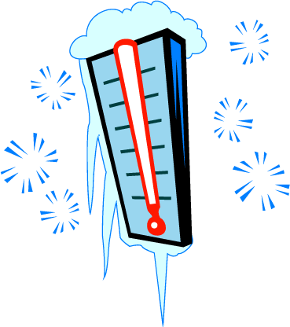
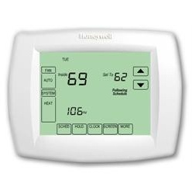

Energy Efficiency & Conservation
To reduce your energy use, you can change your behavior or change the technology that you’re using.
CONSERVATION
EFFICIENCY
Notes:
So how do we save our money? There are two ways – we can conserve energy (don’t use it at all) or we can use energy more efficiently.
Let’s look at ways to conserve-
For example, riding a bike instead of driving a car, conserves gas.
And unplugging computers and other electronics at night or
when not in use, or turning off the lights when you leave a room.

Slide 6
Remember:
The cheapest fuel is the fuel you never have to use!

Slide 7

Energy Saving Tips
From zero cost at-home behavior changes to more expensive upgrades
Residential energy conservation & efficiency tips for heating, insulation & air sealing, water, and appliances inside the home
Available for free download on REAP’s and AHFC’s websites:
https://alaskarenewableenergy.org/library/energy-savers-tips-for-alaskans/
https://ahfc.us/efficiency
*Zoom poll*

Slide 8
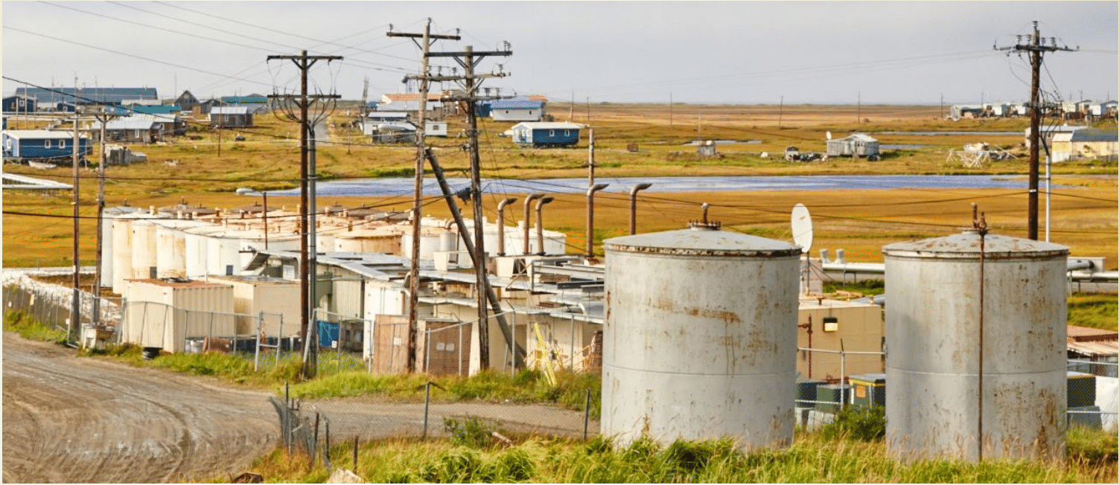
Heating
Notes:
Again, this is the big one – remember we are spending most of our money on heating our homes.

Slide 9
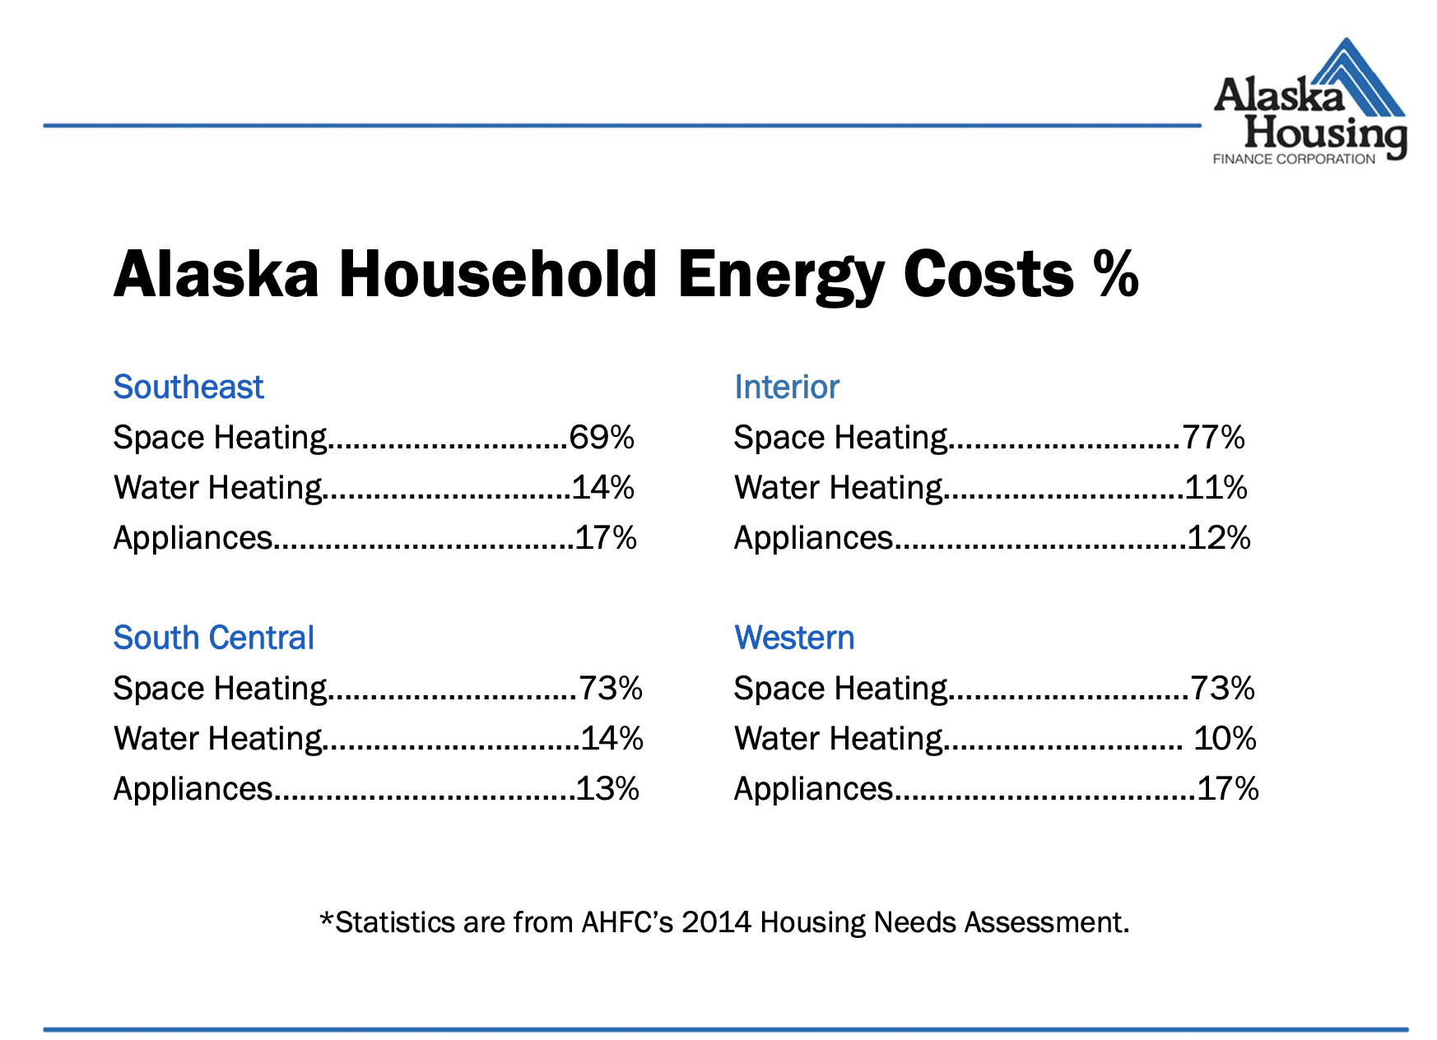
Notes:
Across the board in Alaska, we are spending the most money on heating our homes from an energy perspective.
This slide shows how energy in Western Alaska is being used in the household. Notice that space heating is about 75% of our energy use/costs

Slide 10
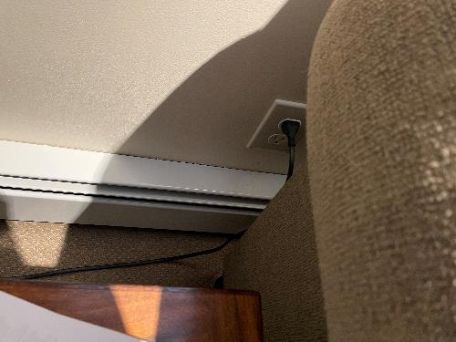
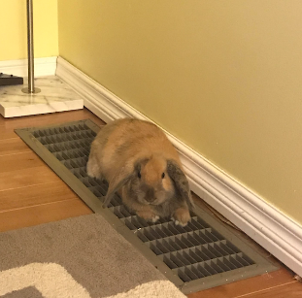
You can:
Check and unblock air vents, radiators, and registers
Seal your fireplace (and other holes) when not in use
Have a professional tune your heating system
  Should be checked every year
  Replace systems older than 15 years
Notes:
If air vents, radiators, and registers are blocked by furniture or drapes, heat cannot circulate throughout the rest of your house
This is an obvious conservation behavior: do not leave windows and door open when your heat is on
Also:
-never use gas or electric stoves for heating – this is very dangerous
-use electric space heaters sparingly – running one for 5 hours a day could cost anywhere from 50 to $125 a month in rural Alaskan households

Slide 11
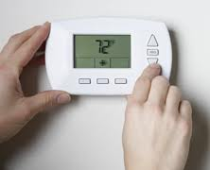
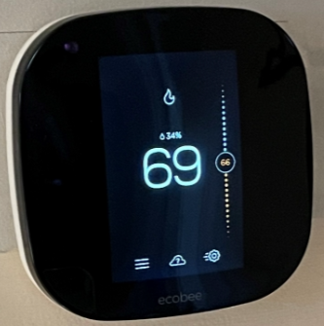
Thermostats
62ºF - 68ºF in winter and turn off in the summer
Every degree you lower = save 2% on your heating bill!
Program if possible:
  set back heat 2 hours before bed & increase just before you wake
  Set back when no one is home
Notes:
-keep health and safety in mind : elders, kids, and those with medical conditions may have greater heating needs

Slide 12
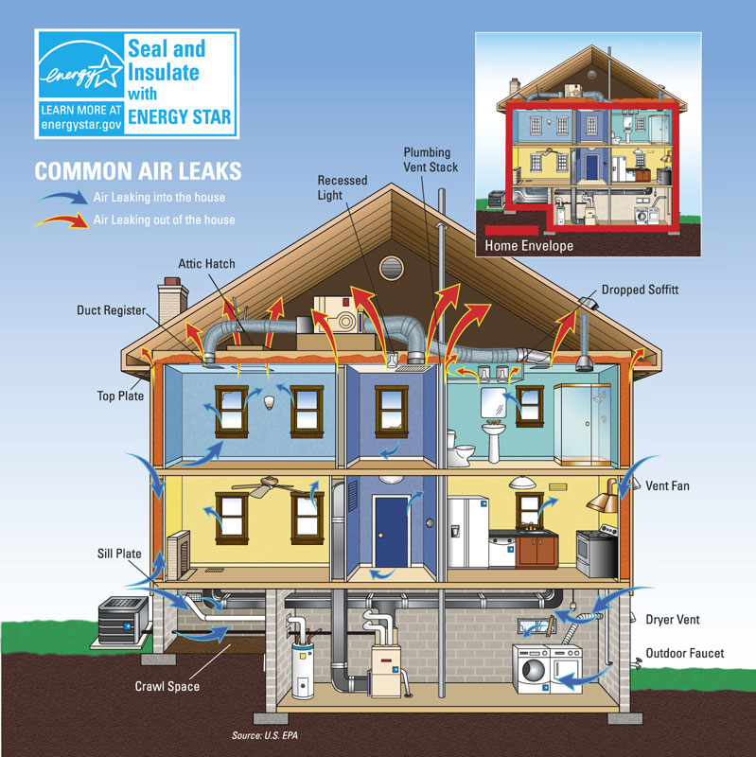
INSULATION & AIR SEALING
Notes:
-Insulation & air sealing work together to minimize heat loss and control moisture
-So this is really inter related to our heating. Proper improvements can reduce heating costs by up to 30%!
Photo from energy.gov

Slide 13

You can:
Identify major air leaks!
Caulk cracks & gaps
Doors: replace thresholds or attach sweeps
Windows: repair & insulate
  Make sure they are fully closed & latched
Install efficient exhaust fans
Photo by Tim Leach
Notes:
Remove towel every 3-4 days to check for moisture build up.
Ensure towel and door area are dry before installing the towel again.
Mold is bad!
-for windows: you can install weather-stripping and window insulation kits (clear plastic film)
In most cases it is not cost effective to replace windows unless they are older than 1980 and are single pane or extremely damaged
Other air-leak detection methods include the following:
Shining flashlight at night over all potential gaps while a partner observes the house from outside. Large cracks will show up as rays of light. Not a good way to detect small cracks.
Shut a door or window on a dollar bill. If you can pull the dollar bill out without it dragging, you're losing energy.
*only insulate water tank with a blanket IF recommended by a manufacturer. Can also insulate pipes
-a certified rater can identify the most effective energy efficiency upgrades
*Demonstration of IR thermometer
*Demonstration of smoke pen - To do this, you will need to close all the windows and doors in your home and turn off any combustion appliances, such as a furnace or water heater. Next you will need to turn on the kitchen and bathroom exhaust vents, which will create a negative pressure in your house that sucks outside air into your home through any crack or opening.
Photo credit: Tim Leach

Slide 14
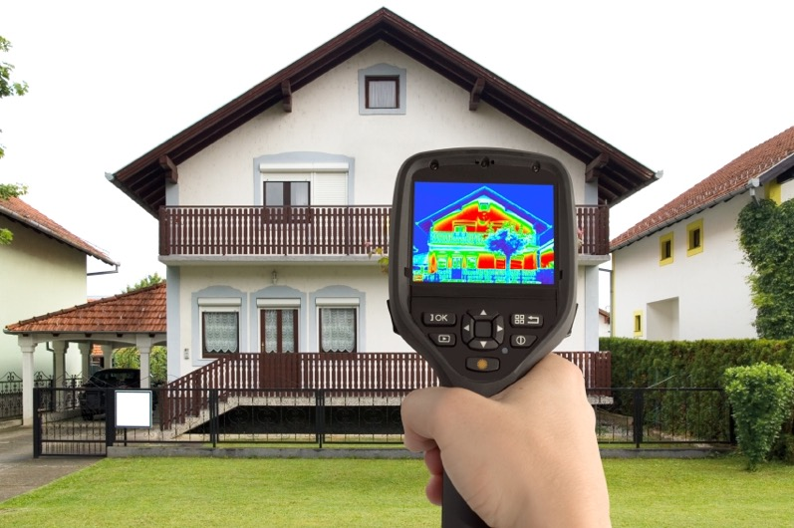
A contractor can:
Identify existing insulation R-values
Inspect vapor barriers
Evaluate/improve attic and foundation insulation
Combustion safety testing
Notes:
-contractor can make recommendations on types and amounts of additional insulation needed
-contractor can identify air leaks in your vapor barrier and repair them
-attic and floor insulation is relative cheap and effective in terms of payback as the floor and ceiling have the highest potential for heat loss
-combustion testing will evaluate ventilation and major appliances to ensure no back drafting of poisonous gases
Picture courtesy of DoE

Slide 15
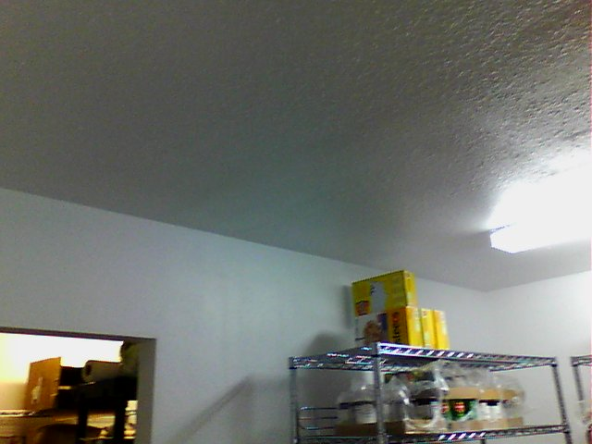
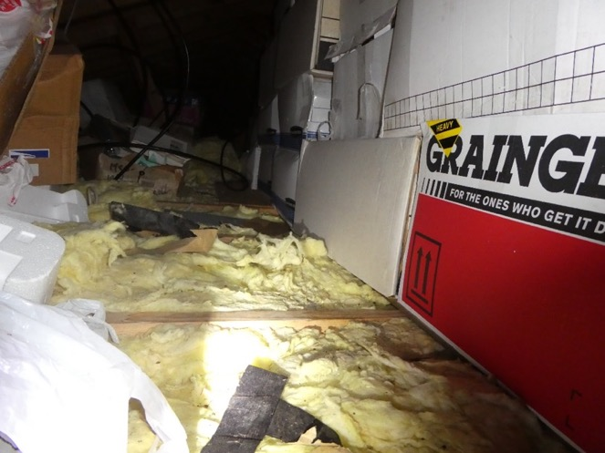
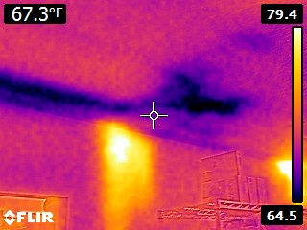
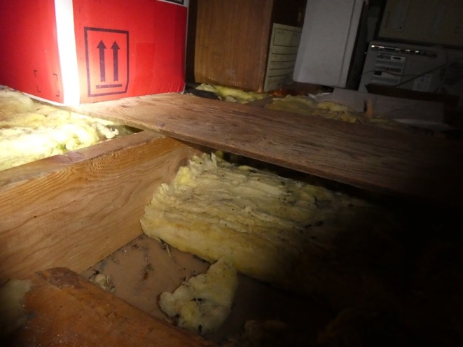
Before
After
Notes:
An example of how insulation can get damaged when folks store a lot of stuff up there, courtesy of AHFC

Slide 16
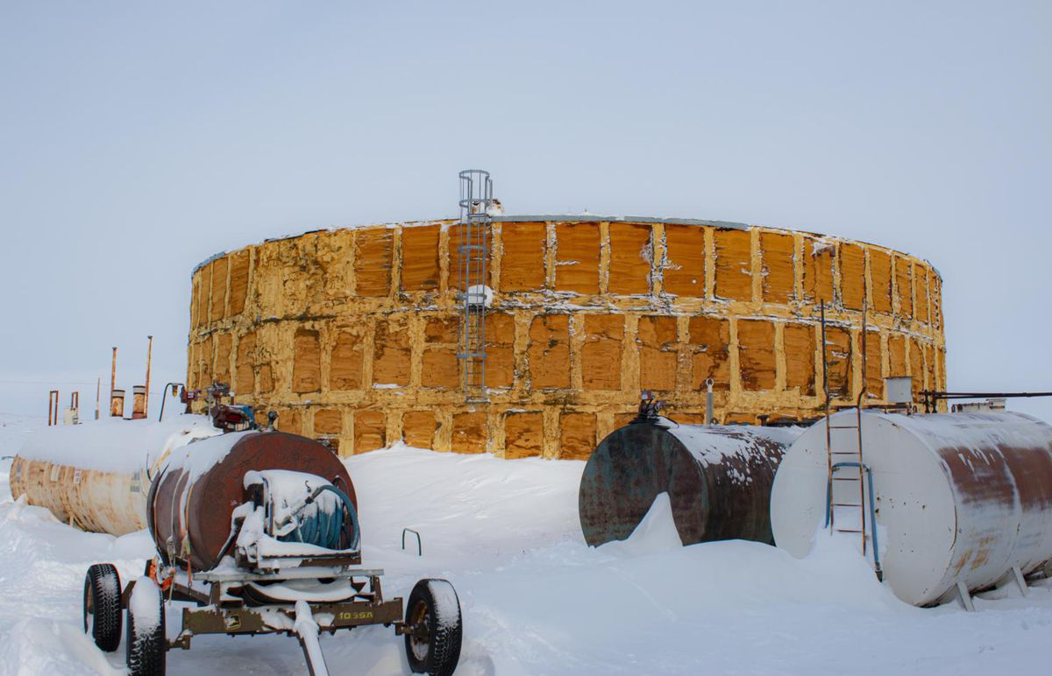
WATER
*Zoom poll*
Notes:
Photo by Photo by JoJo Phillips/KNOM
https://www.adn.com/alaska-news/rural-alaska/2020/05/19/unserviced-why-some-western-alaska-villages-lack-basic-sanitation-infrastructure/

Slide 17
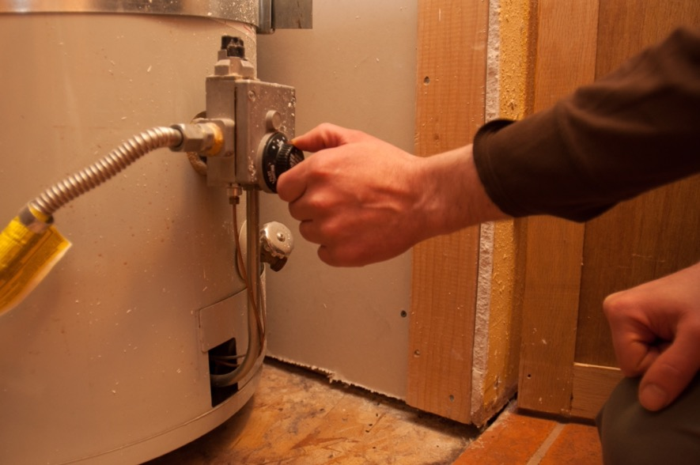
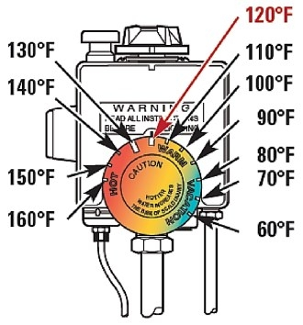
You can: turn down the heat!
Turn down from 140 to 120 and save 6-10% on energy bill.
Notes:
The water heater is the second largest energy user in most homes
Water is often heated to 140 unnecessarily – turning it back to 120 degrees can save between 6 to 10 percent on your energy bill (according to DoE)
Turning down the heat also
-prevents scalding from hotter water
-slows buildup of minerals and corrosion in the water heater and in the pipes
Also make sure you buy a water heater that fits your needs. Insulate if recommended and maintain (drain once a year)
Picture from https://burnshomeconstruction.com/what-temperature-should-a-hot-water-heater-be-set/
Photo credit Tim Leach

Slide 18
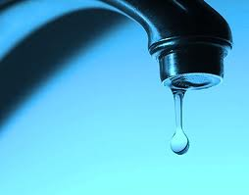
You can:
Don’t let the water run!
Fix leaky faucets and running toilets
Install low-flow showerheads and low-flow aerators on faucets
Add a ”blanket” to older your water heater
Upgrade and/or downsize your water heater
Notes:
-30 drops of water per minute can waste up to 19 gallons of water per month
-low flow showerheads use 1/3 to ½ the water that regular showerheads use and still provide adequate water pressure
-also showers use less hot water than baths
-Replacing old, inefficient faucets and aerators with EPA WaterSense labeled models can save the average family 700 gallons of water per year, equal to the amount of water needed to take 45 showers. Since these water savings reduce demands on water heaters, households will also save enough energy to run a hairdryer 17 minutes a day for a year. From EPA.gov
*Flow rate bag demo

Slide 19

ELECTRICITY
*Zoom poll*
Notes:
This includes lighting, electronics, and appliances in the most home

Slide 20
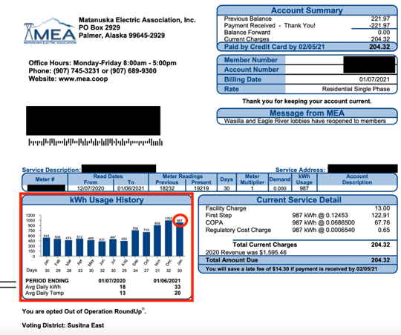
Example bill
•987 kWh usage for the month
•$13 facility charge flat fee
•Variable charges: 122.91+67.76+0.65=191.32
•$191.32/987 kWh = $0.193/kWh
MEA residential rate in December 2020: $0.193/kWh
Notes:
https://www.mea.coop/account-services/understand-my-bill

Slide 21
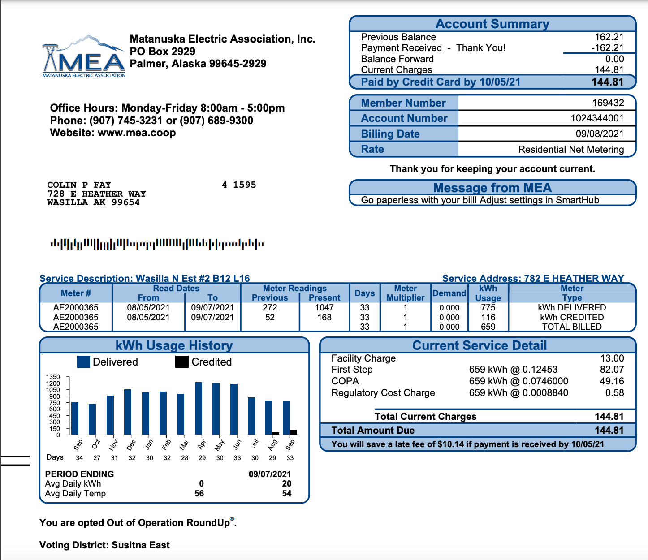
Example bill
•987 kWh usage for the month
•$13 facility charge flat fee
•Variable charges: 122.91+67.76+0.65=191.32
•$191.32/987 kWh = $0.193/kWh
MEA residential rate in December 2020: $0.193/kWh
Notes:
https://www.mea.coop/account-services/understand-my-bill

Slide 22
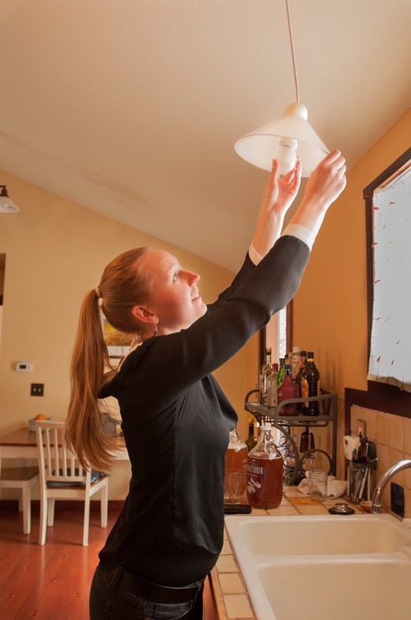
Lighting
You can:
Turn off the lights when not in use
Switch to more efficient lighting
Buy energy star fixtures and lamps
Use timers and occupancy sensors
Notes:
Timers and occupancy sensors automatically turn off lights when not being used
Photo credit: Tim Leach

Slide 23
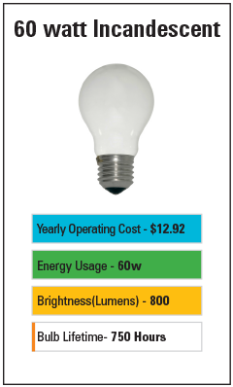
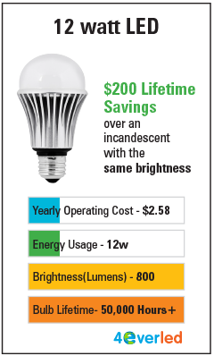
Incandescent vs LED
Notes:
Notes:
-CFLs contain mercury, must be disposed of properly
-linear florescent fixtures can be retrofitted by local contractor

Slide 24
Fast math!
How much would it cost to run a light bulb for 8 hours a day for one year?
100W
incandescent
.10kW * $0.23/kWh * (8*365)hours =
$67.16 a year
14W LED
.014kW * $0.23/kWh * (8*365)hours =
$9.40 a year

Slide 25

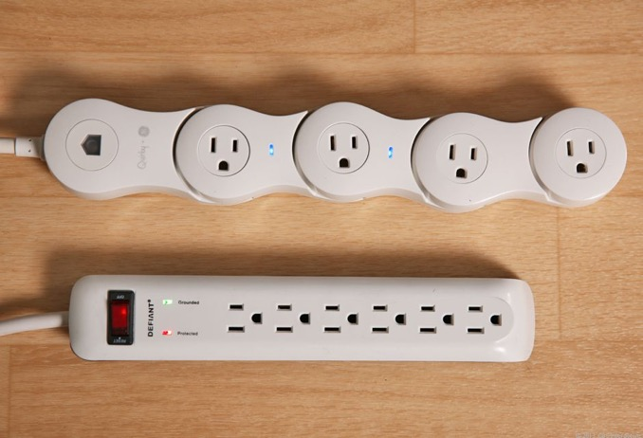
Electronics
You can:
Don’t feed the vampire!
Group and plug into a power strip
Turn off TV when no one is watching
Put in sleep mode
Unplug power adapters and chargers
Notes:
-phantom power or vampire energy: when your electronics draw energy even while they are off. Power strips can help prevent this
-put power strips in easy to reach places so it’s easy to switch off!!

Slide 26
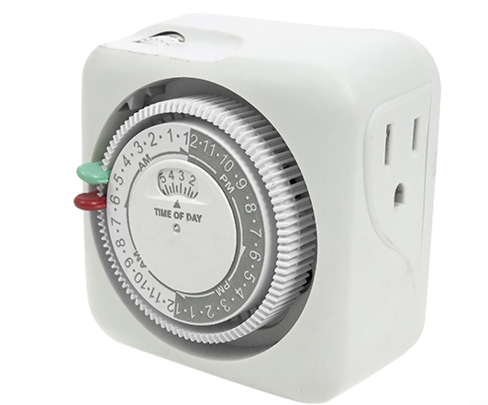
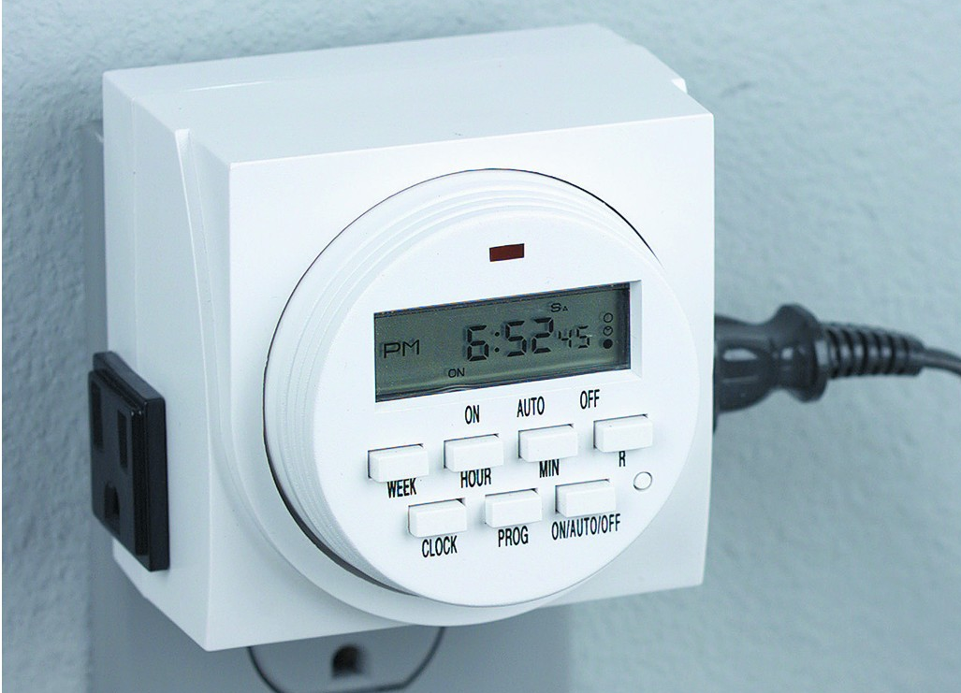
Electronics
Use timers!
Block heaters
Lamps when you’re gone
Tree or other indoor and outdoor string lights
Heat tape
Notes:
-phantom power or vampire energy: when your electronics draw energy even while they are off. Power strips can help prevent this
-put power strips in easy to reach places so it’s easy to switch off!!

Slide 27
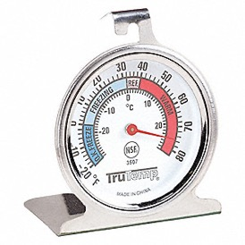

Electronics
You can:
Purchase Energy Star rated appliances
Use your dishwasher if you have one & run only when full!
Clean out the lint
Check the temperature on your fridge/freezer
  36-38ºF for fridge
  0-5ºF for freezer
  Clean the coils & check for leaks in door seal
Notes:
Energy star appliances help consumers save money on operating costs by reducing energy use without sacrificing performance
Appliances with the label meet strict energy efficient guidelines set by EPA and DoE
Photo credit: lowes.com

Slide 28
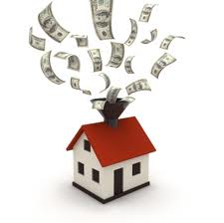
What did you just tell me?
Notes:
I just threw a lot of information at you, and you may be thinking: what do I do first? Or, this seems expensive! So I will break it down by cost.

Slide 29
Energy conservation is free!
Turn off the lights you don’t need them
Group electronics on power strips and turn off when not in use
Turn down the heat on your thermostat and water heater
…and much more!
Notes:
First, remember that energy conservation is all about changing your behavior. And changing your behavior is free (and is actually money in the pocket when thinking about potential savings, with no upfront cost).

Slide 30
Efficiency may cost you $$ up front, but will save you in the long run
….and some efficiency measures are relatively low-cost (& DIY)
Notes:
And there are really simple tools you can use to determine which efficiency upgrades you may need.

Slide 31
Simple payback
Simple Payback = Initial cost / (annual energy cost savings + annual maintenance cost savings)
Notes:
You can see that envelope upgrades take a long time to pay back when compared to installing a programmable thermostat
…that’s because while they may save the same amount of money, it costs so much more to make envelope improvements and almost nothing to add a programmable thermostat
Important to note that this is not the whole story, because it only gives us a time for payback but not how much we are actually saving once we pay it off (for example, attic insulation might save us more per year than a programmable thermostat).

Slide 32
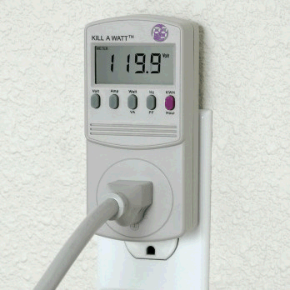
You can’t manage what you don’t measure
Look at your energy bill each month
Become aware of habits and usage
Measure and monitor
  Electricity monitor
  Freezer/fridge thermometer
Reduce and save!
Notes:
Before you start reducing your energy usage, it’s helpful to have an idea of how much energy you consume and what you are currently paying in electric and heating bills each month.
You can also track habits and usage, like how many times you run the dishwasher or do the laundry in a given week, how many lights your leave on at night, what electronics are always plugged in and on, etc.
*Kill-a-watt meter demo
*Hygrometer

Slide 33
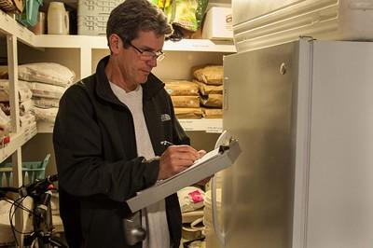
ENERGY ASSESSMENT TOOL
Notes:
http://www.akenergyauthority.org/What-We-Do/Power-Cost-Equalization
Infographic created by Laura Tellez when she worked at AHFC

Slide 34
Home Energy Assessment Tool
Basic Home Energy Assessment Checklist
Can be done without supplies
  Maximize use with: digital thermometer, freezer/refrigerator thermometer, and electricity monitor
Can go into more detail
Available for free: https://akenergysmart.org/lesson-plans/home-energy-assessment/

Slide 35
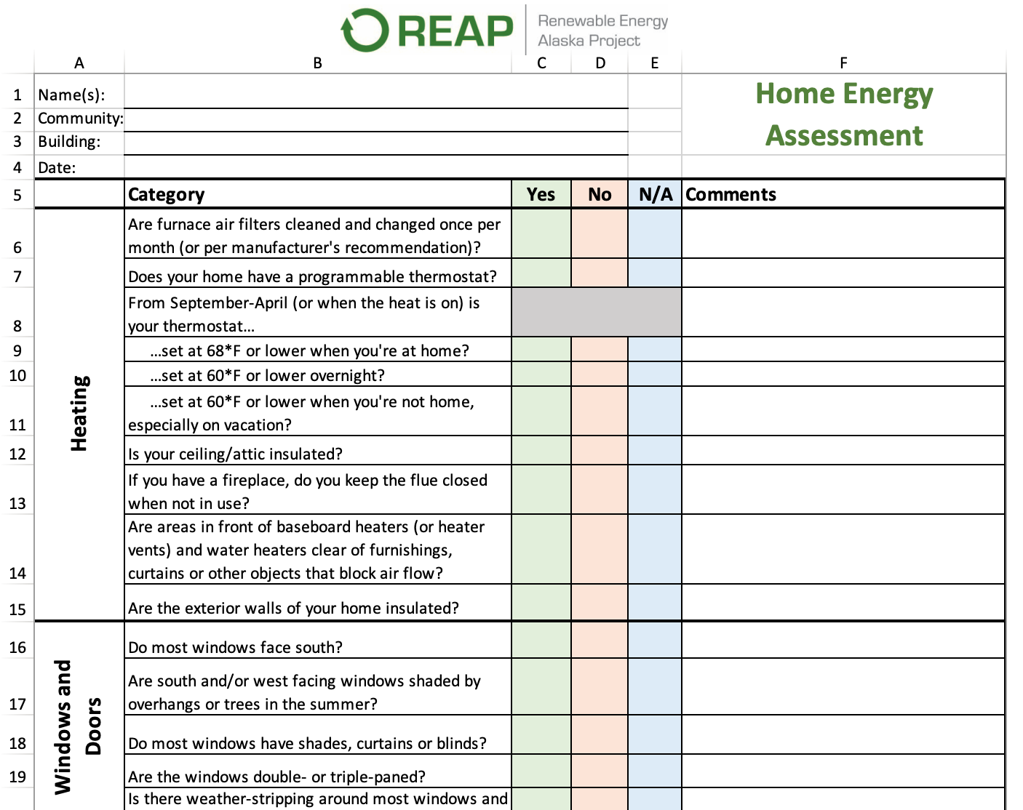

Slide 36


Additional Resources
Alaska Housing Finance Corporation (AHFC)
  To learn about energy efficiency programs, visit the Research Information Center (RIC), & sign up for free classes www.ahfc.us
Renewable Energy Alaska Project (REAP)
  Clearing house for clean energy resources www.alaskarenewablenergy.org/library
The Cold Climate Housing Research Center (CCHRC)
  Mission is to help meet the challenge of building energy efficient homes in cold region. To learn more: www.cchrc.org

Slide 37

In conclusion
You don’t have to be an expert to start saving energy
There’s things you can do at little to no cost
Please share with your fellow community members!
Colleen Fisk, education@realaska.org

Slide 38
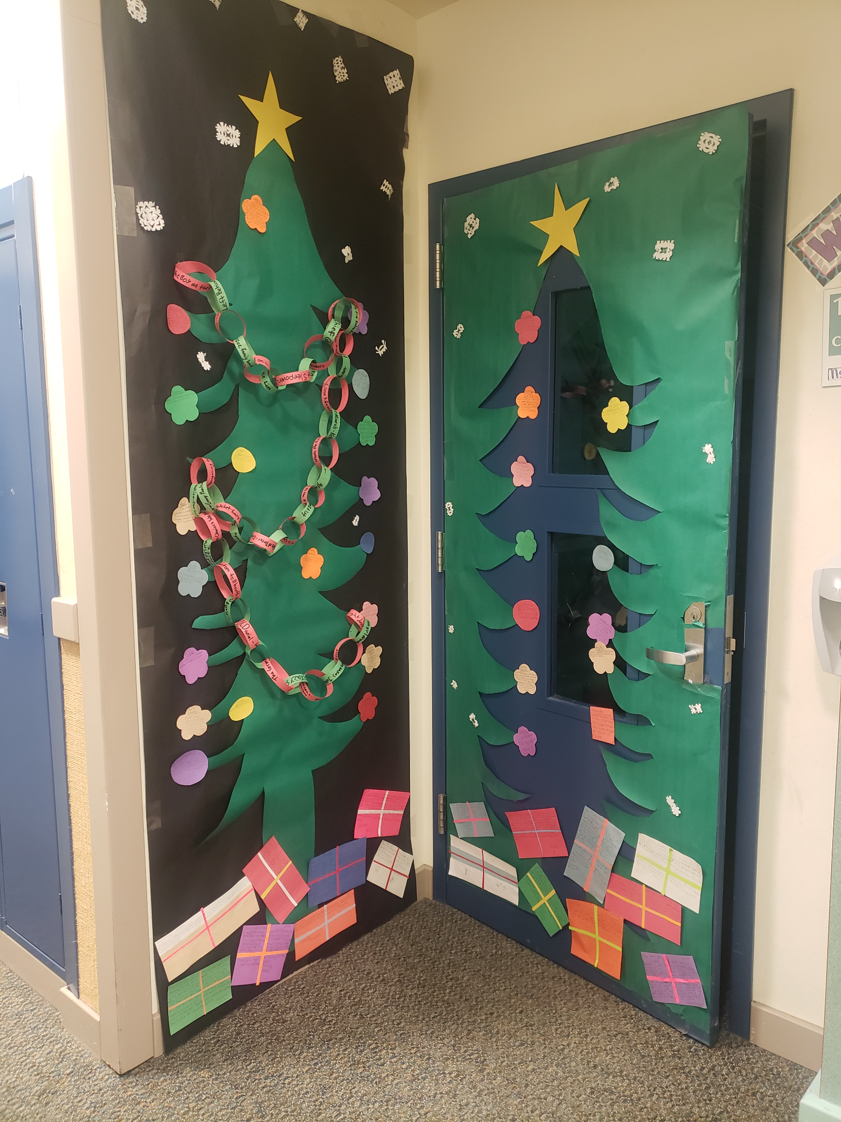

Koyuk Malemute School
Koyuk Malemute
Grade(s): 6-8th
Students decorated a christmas tree using scrap paper for ornaments, gifts and reading links
These holiday decorations are energy efficient and sustainable because the students reused scraps of paper that would have been thrown out to make something decorative.

Slide 39
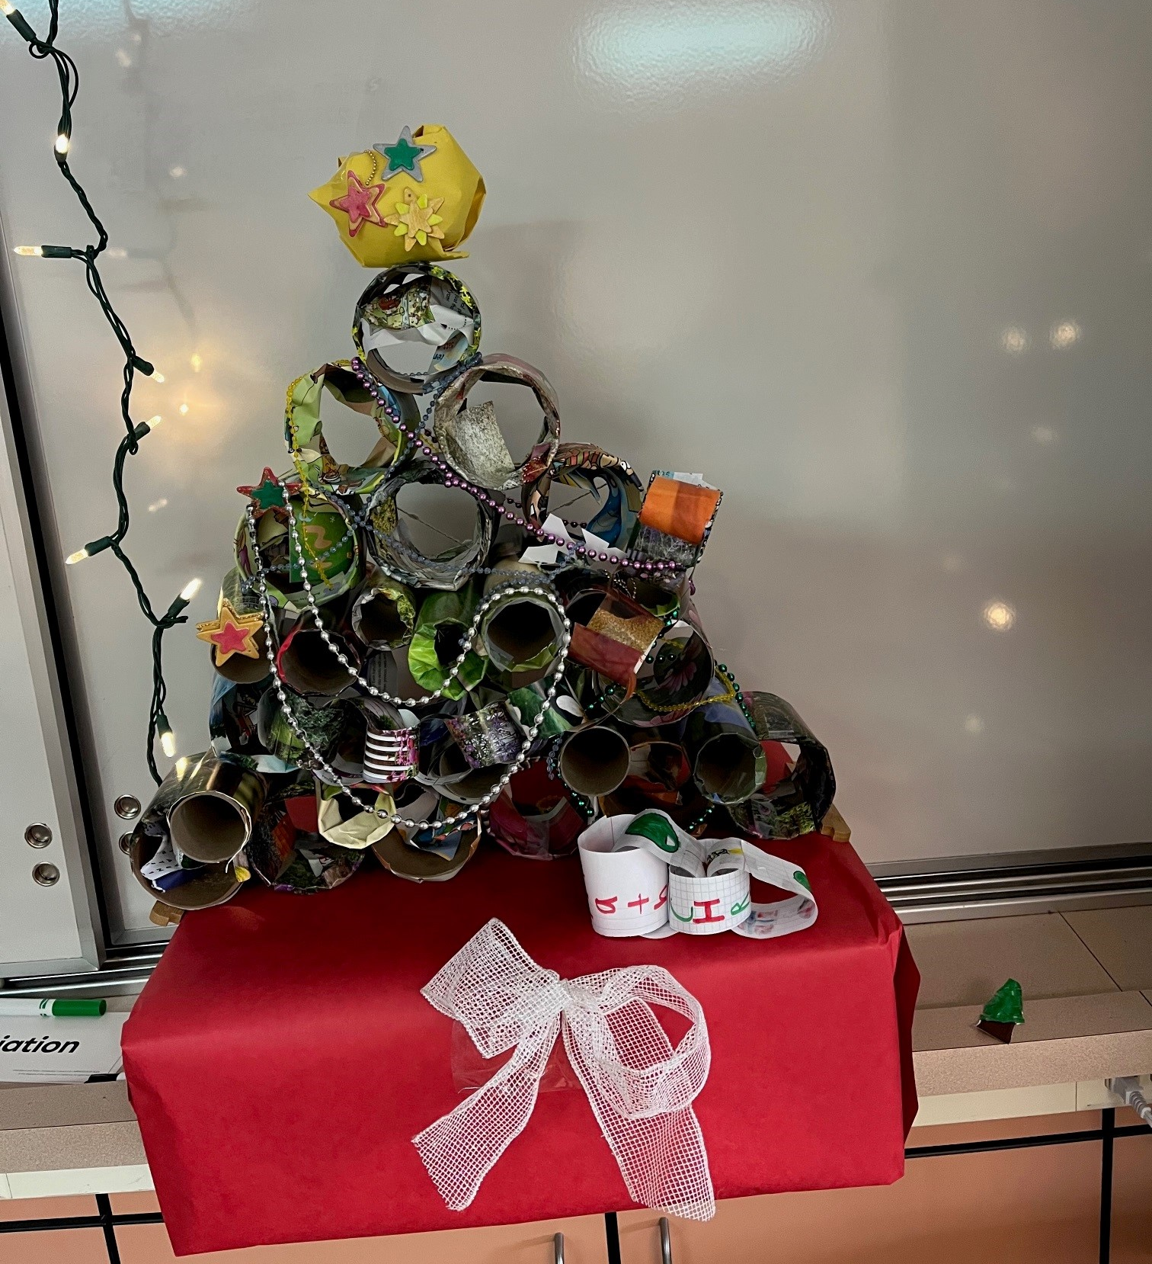
Talkeetna School
Talkeetna
3rd Grade
Recycled tube and magazine picture Tree
Everything we used to make the tree was on its 2nd or third use. We had fun looking through the re-usable materials and working together. The string lights behind the tree are LED.
Add photo(s) of decorations here

Slide 40

Quyana Tsín’ȩȩ
Mahsi’ Basi
Gunalchéesh Tsin’aen
Baasee’ Tsen’anh
Xasadigaghisidhoot
Igamsiqanaghhalek

