Slide 1


Slide 2




Cold Climate Weatherization Installer Badges
Online skills development for weatherization and energy efficiency installation tactics.
25 standard badges adapted for cold climate building
mastery of online content and completing the skill on site will earn a “badge”
visit cchrc.org/badges to learn more and enroll!

Slide 3
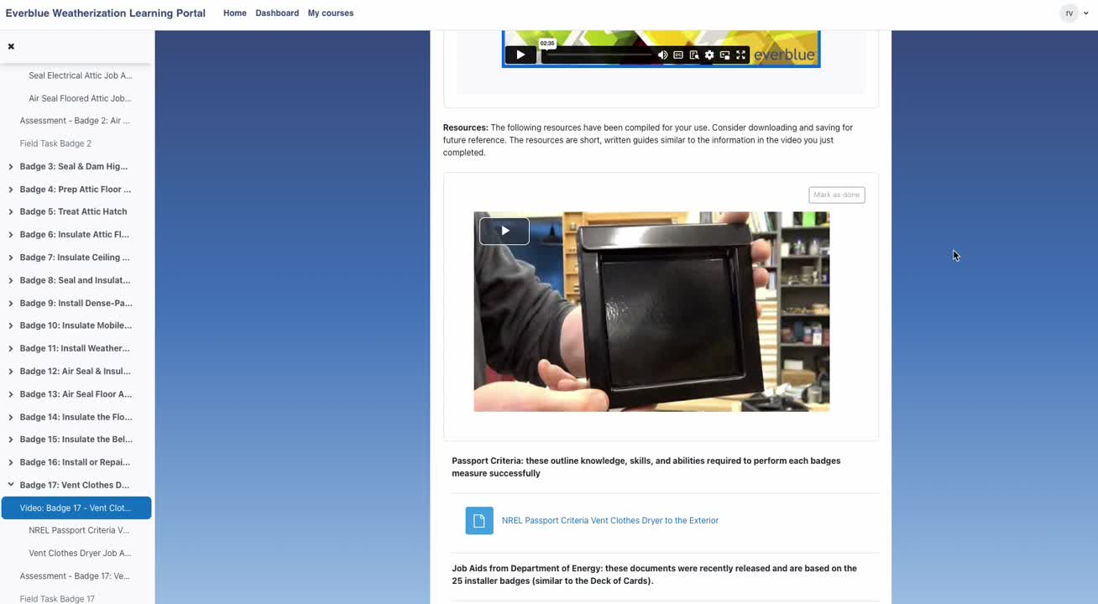

Slide 4
Build smarter, build stronger—join the CCHRC Badges Program today!
We’re looking for:
  builders to participate as Quality Control Inspectors (QCIs)
  employees to train as students and enhance their skills
  organizations that want to purchase bulk deals or offer scholarships.
Sign up before December 16th
for our Early-Bird discount. Only
$35 for access to all 25 badges.
Prices go back to $50 per person
on December 17th.
Program launches December 9th!
Strengthen your team and
help grow Alaska’s workforce!

